Slide 1

BASIC OF CIVIL ENGINEERING (TCE 201)
UNIT- 1 Lect-3

Slide 2
Scope of civil engineering
The main scope of civil engineering or the task of civil engineering is planning, designing, estimating, supervising construction, managing construction, execution, and maintenance of structures like building, roads, bridges, dams, etc.
Civil engineering is concerned with planning, design and construction for environmental control, development of natural resource, buildings, transportation facilities and other structures required for health, welfare, safety, employment and pleasure of mankind.
It also includes renovation of the already existing structures. The intention behind this is not only to make the place where we are residing more beautiful for the eye, but also to make the world a much safer place to live in.

Slide 3
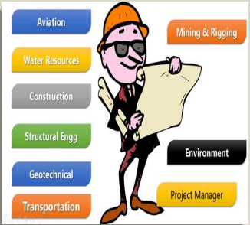
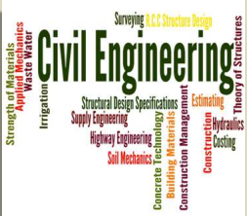
Branches of civil engineering
SURVEYING & LEVELING
BUILDING, PLANNING AND CONSTRUCTION
STRUCTURAL ENGINEERING
GEOTECHNICAL ENGINEERING
WATER RESOURCES ENGINEERING
TRANSPORTATION ENGINEERING
ENVIRONMENTAL ENGINEERING

Slide 4
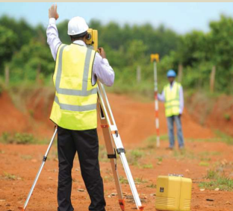

Branches of civil engineering
SURVEYING & GEOMATICS

Slide 5
Branches of civil engineering
SURVEYING AND GEOMATICS
Geomatics is the new name for an expanded technical area of what used to be called surveying or surveying engineering.
Surveying, the first step of starting a new civil engineering project, it is a very important branch of civil engineering.
Surveying is an art which enables the engineer to determine relative positions of points on, above or beneath the earth’s surface by means of direct or indirect measurements of distance direction and elevation.
Surveying is carried out to fix the alignment of road, railway canal. It is also useful in selecting the site for the construction of structures
Modern surveying instruments like Electronic total station and Geographical Positioning System(GPS) are the modern electronic digital instruments for survey works.
Remote sensing and Geographical Information system(GIS) are adopted for surveying and planning of many civil engineering projects.

Slide 6
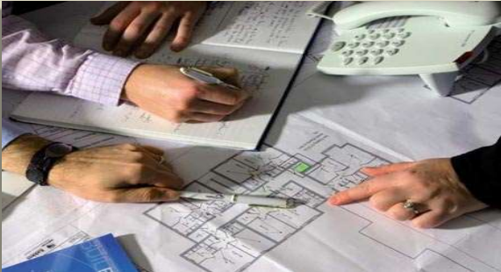

Branches of civil engineering
BUILDING PLANNING AND CONSTRUCTION
Civil engineers are concerned with many types of structures of which buildings are of prime importance.
Buildings are planned according to the fundamental principles of planning & bylaws of local municipal bodies.
Building planning requires basic knowledge of principles of architecture.
Buildings may be residential or public building like school, colleges, government office, hospitals, etc. they are designed according to need of specific occupants and purposes.

Slide 7
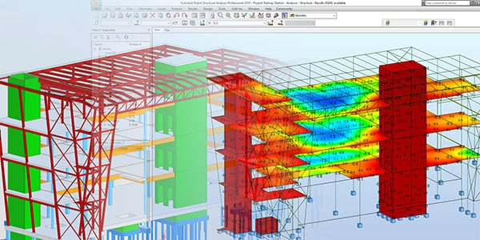
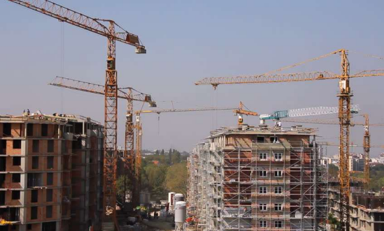
Branches of civil engineering
STRUCTURAL ENGINEERING

Slide 8
Branches of civil engineering
STRUCTURAL ENGINEERING
This Branch of civil engineering deals with structural analysis and design of structures.
Structural analysis is done to calculate stresses in structural components, on the basis of loads, acting on structures.
Sections of structural elements like beams, columns, slabs, etc. are designed.
Structural analysis requires much calculation, hence advanced computing software's are used to carry out structural analysis and design.
It includes design of reinforced cement concrete ( RCC) and steel structures, design of Multistoried buildings, towers, retaining walls, water tanks, bridges requires skills and knowledge of structural engineering.

Slide 9

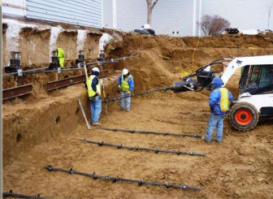
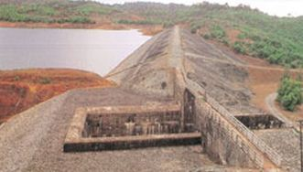
Branches of civil engineering
GEOTECHNICAL ENGINEERING

Slide 10
Branches of civil engineering
GEOTECHNICAL ENGINEERING
Geotechnical engineering is that field of civil engineering which deals with soil investigation and design of proper foundations of structures.
Soil investigation includes collection and testing of soil samples.
Geotechnical engineering includes measurement of soil parameters and safe bearing capacity. It also includes construction and design of simple foundations, pile foundations, well foundations, caissons, coffer dams, construction of foundation of dams, construction of tunnels, sub base of road, earthen dams, earth related constructions.
Sound knowledge of geology and geotechnical engineering is necessary for construction of earth related structures.
As such, the geotechnical engineer is involved in field and laboratory investigations to determine the engineering properties of site soils and other geomaterials and their subsequent use in the analytical study of the problem at hand.

Slide 11
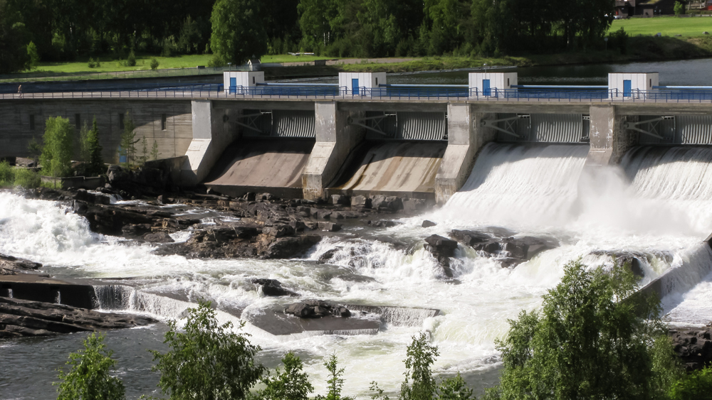
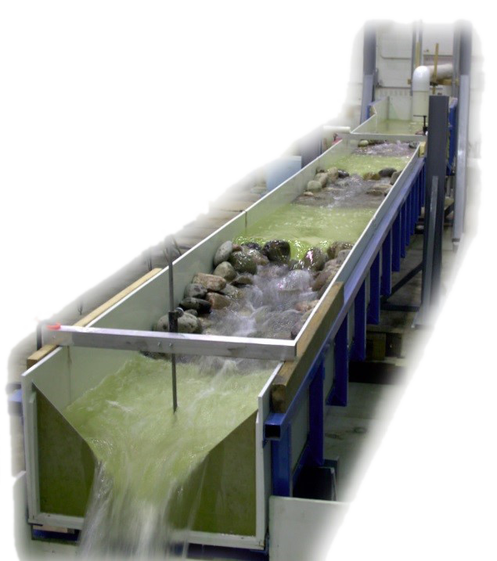

Branches of civil engineering
WATER RESOURCE ENGINEERING

Slide 12
Branches of civil engineering
WATER RESOURCE ENGINEERING
Water resource engineering means measurements, utilization and development of water resources for agriculture, municipal and power generation purpose.
It mainly includes irrigation engineering, design of hydraulic structures like dams, canals, etc. Water resource engineering deals with planning designing and developing water resources by constructing several hydraulic structures like dams, barrages, hydropower stations, canal and pipe networks etc.
It also includes watershed planning, water harvesting techniques, soil conservation and soil reclamation.
Hydrology is also a part of water resource engineering. Hydrology includes study of sources of water, measurement of rainfall, study of rainfall, runoff, flood control.

Slide 13
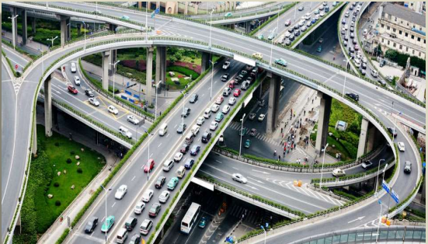
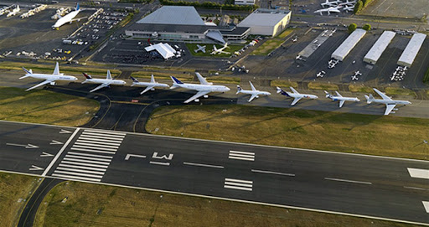
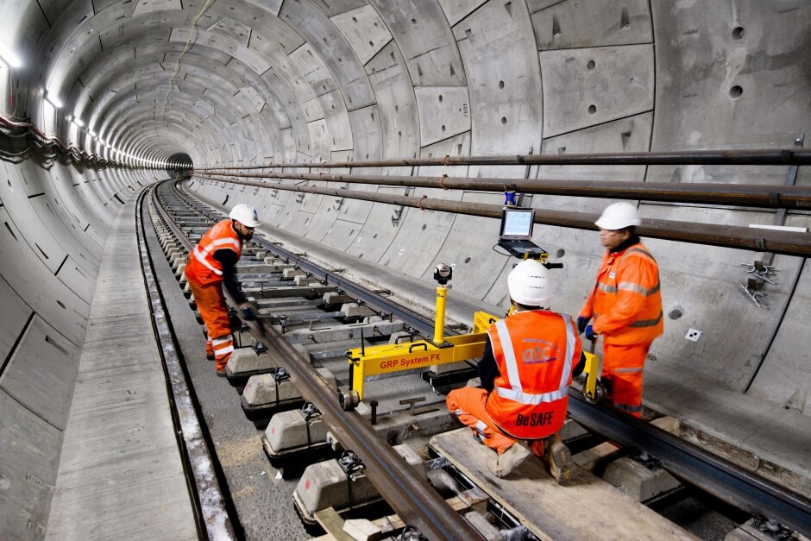
Branches of civil engineering
TRANSPORTATION ENGINEERING

Slide 14
Branches of civil engineering
TRANSPORTATION ENGINEERING
Transportation means movement of passengers and goods by means of vehicles on land, ship on water and aircrafts in air.
Transportation Engineering is that branch of Civil engineering which deals with planning, designing and construction of roads, bridges, railways, tunnels, harbours, ports, docks, runways, and airports.
As for development of any nation good transportation network is of prime importance. Study of various construction materials used in construction of roads, traffic engineering are also considered under transportation Engineering.

Slide 15

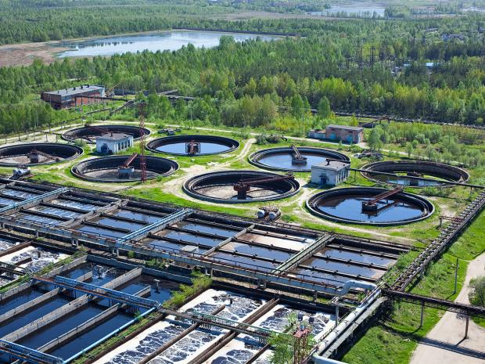


Branches of civil engineering
ENVIRONMENTAL ENGINEERING

Slide 16
Branches of civil engineering
ENVIRONMENTAL ENGINEERING
Environmental Engineering deals with pollution control and public health engineering.
Different types of pollutions are water, air, noise and other pollution.
Due to large scale industrialization, population growth, rapid urbanization and several other human activities like construction, mining, transportation, environment gets polluted.
Environmental engineering deals with technologies & facilities which are engaged in reducing pollution.
Environmental engineering includes design, construction and maintenance of water treatment plant, waste water treatment plant, water distribution network and sewerage system, it also deals with solid waste management in towns and cities.
Public health engineering includes water treatment, water distribution network, & solid waste management.

Slide 17
Thank you

